Slide 1


UNDERSTANDING DISABILITY:
Disability Inclusion Training
Toolkit for Disability Inclusion in Care Reform
Notes:
Acknowledgement
The Toolkit for Disability Inclusion in Care Reform was produced by Changing the Way We CareSM (CTWWC), an initiative designed to promote safe, nurturing family care for children. It represents a collection of work developed from the experience of many practitioners. These slides for the Understanding Disability Training and the accompanying training facilitator’s guide were designed by disability and care reform practitioners and consultants for CTWWC with an aim is to build the capacity and confidence of those working in family strengthening and children’s care for work with children with disabilities and their families. We thank the following people and organizations: Elayn Sammon, Gwen Burchell, Leia Isanhart, Catholic Relief Services, and the CTWWC teams in Kenya and Guatemala for their input, feedback and pilot testing.
As Changing the Way We Care and partners learn from and promote family care we commit to full and meaningful inclusion of children with disabilities and their families throughout the process of care reform and all of our work. Children with disabilities disproportionately live in residential care and are, too often, the last to be deinstitutionalized. We commit to putting them first.

Slide 2

By the end of this workshop you will be able to…
…define disability
…describe the relationship between poverty and disability
…identify steps to take toward inclusion
…understand the basics of disability etiquette
…understand how disability impacts family strengthening programming
…identify roles in mitigating barriers faced by children with disabilities and their families
LEARNING OBJECTIVES

Slide 3

Reflection
What does the word disability mean to you?
What is your reaction when you see a person with a disability?
What personal experience do you have with disability, either with your own lived experience, within your family, or in your community?

Slide 4
Defining Disability
Persons with disabilities have long-term physical, mental, intellectual or sensory impairments which in interaction with various barriers may hinder their full and effective participation in society on an equal basis with others
  Limited Activity- difficulty encountered by an individual in executing a task or action
  Restricted participation- problem experienced by an individual in involvement in life situations
  Impairment- problem in body function or structure, with varying severity

Slide 5
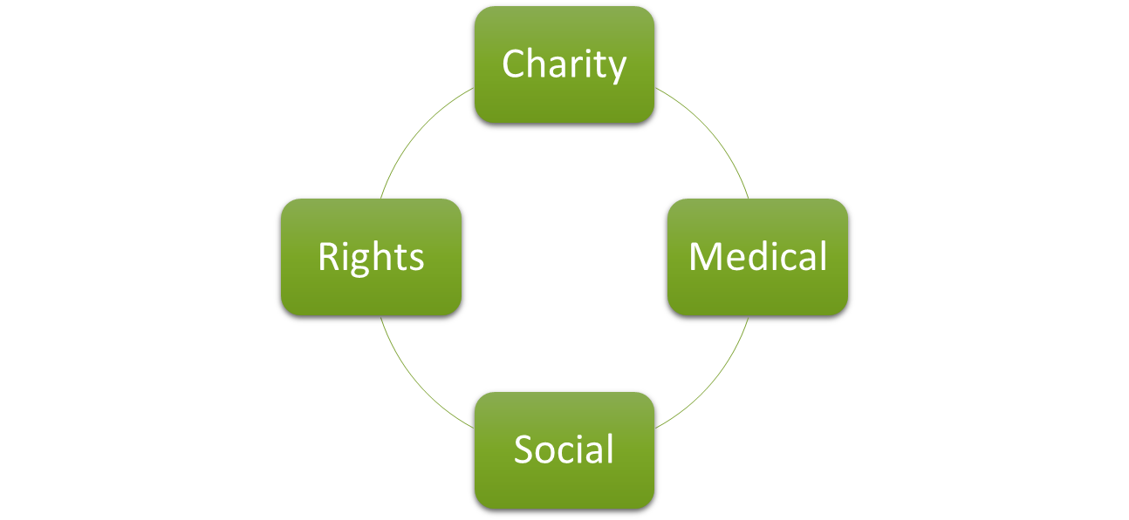
Disability Models

Slide 6
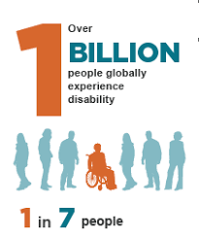

Global disability statistics
15% of global population
80% of people with disabilities live in developing nations
20% of people who live on < $1.25 per day in the world have a disability
6
Notes:
https://apps.who.int/mediacentre/infographic/dar/en/index.html

Slide 7
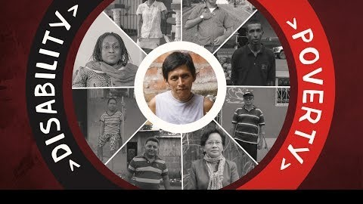
Disability and Poverty video
Source: EndTheCycle CBM "The Cycle Explained"
Notes:
Access the video: https://youtu.be/ca64-46rDm0

Slide 8
Cycles of Poverty & Disability
Disability
Denial of opportunities for economic, social & human development
Social & cultural exclusion & stigma
Vulnerability to poverty & ill health
Reduced participation in decision making & denial of civil & political rights
Poverty
Deficits in economic, social & cultural rights
Notes:
Grills, Nathan & Singh, Lawrence & Pant, Hira & Varghese, Jubin & Gudlavalleti, Murthy & Hoq, Monsurul & Marella, Manjula. (2017). Access to Services and Barriers faced by People with Disabilities: A Quantitative Survey. Asia Pacific Disability Rehabilitation Journal. 28. 23-44. 10.5463/DCID.v28i2.615.

Slide 9
Why should we care?
“This is not just the right thing to do for common humanity – but it is the smart thing to do in ending extreme poverty. If we get things right for people with disabilities, we get things right for all people.”
Penny Mourdant, Secretary of State for International Development, UK. Global Disability Summit, July 2018

Slide 10
Inclusion involves…
Getting
Getting fair treatment from others (nondiscrimination)
Making
Making products, communications, and the physical environment more usable by as many people as possible (universal design)
Modifying
Modifying items, procedures, or systems to enable a person with a disability to use them to the maximum extent possible (reasonable accommodations)
Eliminating
Eliminating the belief that people with disabilities are unhealthy or less capable of doing things (stigma, stereotypes)

Slide 11
Inclusion in Action
Invite persons with disabilities to be part of the solution
Include the voices and interests of people with disabilities in project design, implementation, and evaluation
Collect disability-disaggregated data
Identify and address barriers to participation
Use accessible information and communication
Set aside a disability inclusion budget of 3-5%
Hire staff with disabilities

Slide 12
Inclusive Communities look like this
Inclusive Communities
Source: WHO

Slide 13
Disability Terminology
DO | DON’T
Person with a disability; persons with disabilities, children with disabilities | Disabled Person
 | Outdated terms: Handicapped, crippled, etc.
 | Jargon: Physically challenged; differently abled
 | Negative, disempowering words: victim, sufferer
Uses a wheelchair | Confined to a wheelchair; wheelchair bound
Deaf, deaf, hard of hearing
Person with a physical disability | Lame, crippled
Nonverbal, nonspeaking | Mute, dumb
Person with an intellectual, developmental, or cognitive disability | Mentally defective, mentally challenged, retarded
Notes:
https://www.usaid.gov/sites/default/files/documents/2496/Disability Communications Tips_508 %281%29.pdf

Slide 14
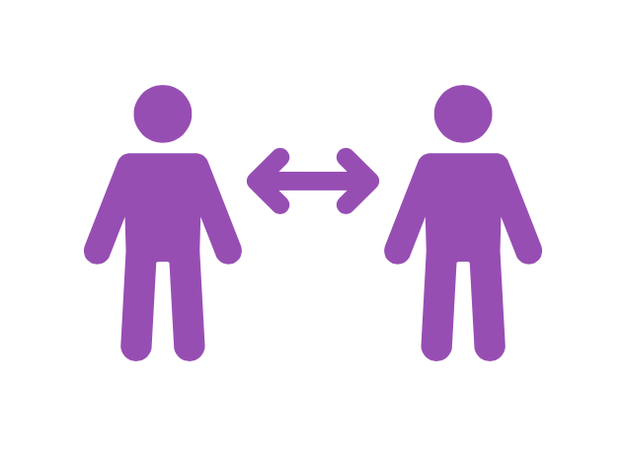
Etiquette
Don’t touch personal equipment
Don’t victimize
Don’t assume
Adjust posture to eye-level
Make eye contact
Ask before providing assistance
Don’t underestimate abilities
Speak to the person before his/her caregiver
Notes:
https://disabilityin.org/resource/disability-etiquette/
https://www.vantagemobility.com/blog/disability-etiquette-dos-and-donts
https://www.forbes.com/sites/andrewpulrang/2020/09/30/here-are-some-dos-and-donts-of-disability-language/?sh=2ea703cad170
https://www.youtube.com/watch?v=Gv1aDEFlXq8

Slide 15
Reflection
What questions do you have?

Slide 16

Rights Perspective
UN Convention on the Rights of the Child
UN Convention on the Rights of People with Disabilities
  Views persons with disabilities with rights, capable of claiming rights & making decisions based on free / informed consent
  Active members of society
  Human rights instrument with social development dimension
  Broad categorization of persons with disabilities
Notes:
https://www.un.org/development/desa/disabilities/convention-on-the-rights-of-persons-with-disabilities.html

Slide 17
Reflection
How do these rights play out in your country or community?
How are they upheld?
What are the challenges to children with disabilities (and their caregivers) claiming those rights?

Slide 18
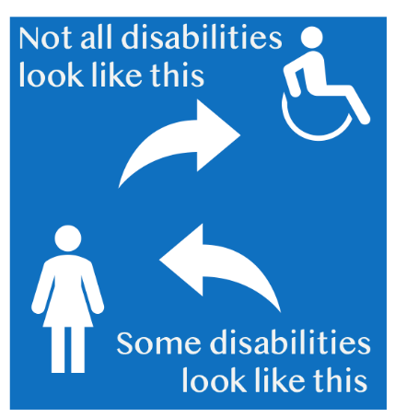
Disability in Children: visible & invisible
Does not use words to communicate on time
Does not understand simple directions
Speech is difficult to understand
Not sitting, crawling or walking on time
Cannot hold or manipulate toys
Difficulty in preparation for school
Cannot hold pen correctly or has poor handwriting
Cannot use toilet, dress or feed self appropriately
Hypersensitive or hyposensitive to the environment
Shows unusual or uncontrollable behavior
At birth or acquired
Impacts function
Impacts internal and external senses

Slide 19
Reflection
Not all disabilities are visible. What does this mean for our work?
How does institutionalization or family separation further impact a child with disability?
What are parents told by the community or doctors about their child with disability? How does that impact separation?
What community services could help parents keep their children with disabilities with them?
What’s your role in addressing those service gaps?

Slide 20
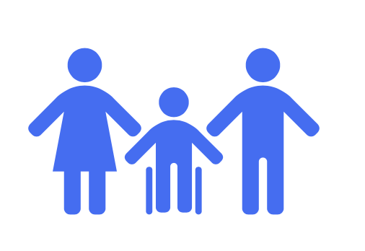
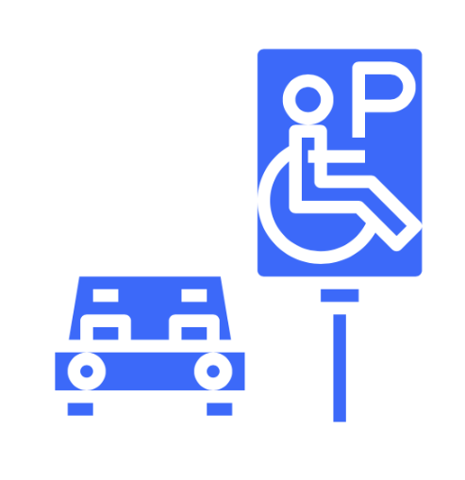
Impact of Disability
The child, in the present and future
Siblings
Parents
Family
Services
Society

Slide 21
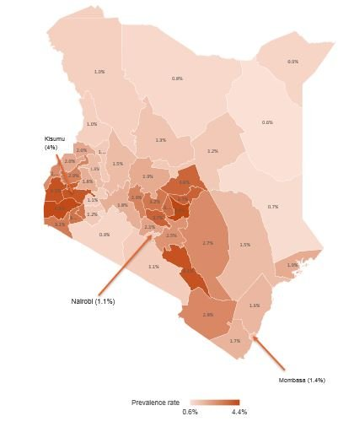
Why inclusion? Example of Kenya
Disability is a key driver of child-family separation in Kenya
Children with disabilities are disproportionately represented in institutional care and more at risk of separation
Due to their complex needs and social barriers to inclusion, children with disabilities are often the first to be placed in institutional care and the last to leave
They can also be the hardest children to find in your community, because they face stigma and discrimination and thus can be kept hidden
Notes:
Source: https://devinit.org/resources/status-disability-kenya-statistics-2019-census/
Kenya’s population may have lower than average rates of disability. Disability prevalence increases with age, and so countries with large aging populations will have higher prevalence rates. Kenya has a young population and so could have lower disability prevalence rates than some other countries.
Statistics here are for ages 5 and up

Slide 22
Inclusion Strategies: Example of Kenya
Working with GOK, OPDs and other stakeholders
Mapping disability inclusion stakeholders
Mapping children/ families with disabilities
County level stakeholders training
Community awareness on disability inclusion
CTWWC staff training on disability
Notes:
This graphic shows examples of inclusion from the Changing the Way We Care initiative in Kenya. Examples are from 2020/2021
Stakeholder training on disability identification and improved service provision
Used maps of children/families with disabilities to improve referrals and service outreach
With the stakeholder maps, developed stakeholder directory and conducted county level stakeholder forums
Staff training touched on topics including: basics of inclusion, understanding disability and etiquette, local systems for early identification, and the role of various stakeholders in referrals.

Slide 23
Reflection
Why is inclusion important in our context?
How can we respond to the impact of disability our programming?
What’s holding us back right now?

Slide 24
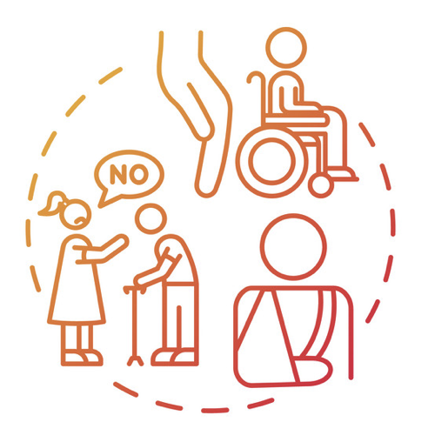
Overcoming Stigma & Discrimination
Stigma
Attitudes, beliefs, and terminology that lead people to reject, avoid or fear those they perceive as being different
Discrimination happens when individuals or institutions unjustly deprive others of their rights and life opportunities due to stigma.

Slide 25
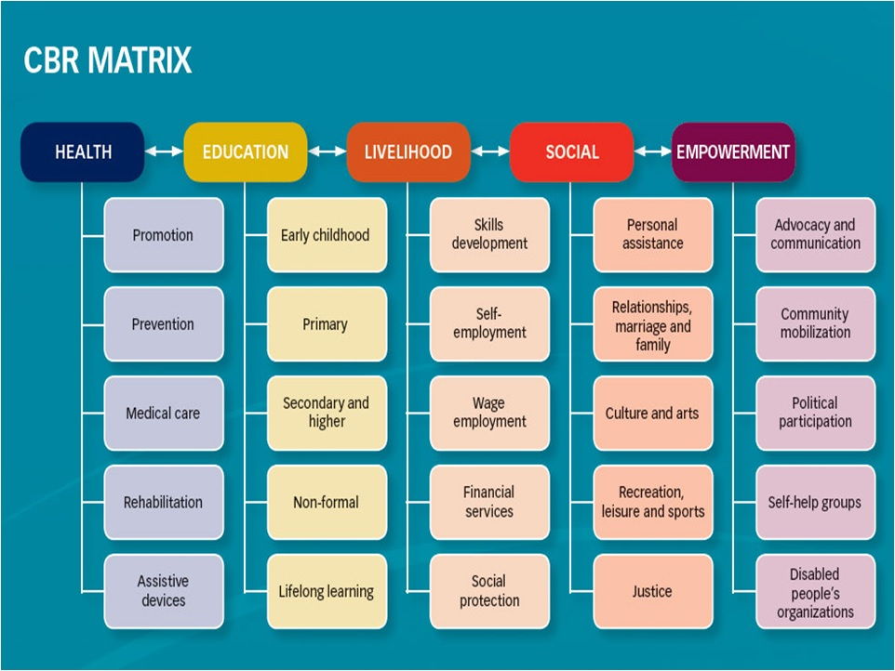
Importance of Community Engagement
Faith communities
Schools
Health centers
Parent Networks
Community Based Rehabilitation
Organizations of Persons with Disabilities
Source: CBR Africa Network (CAN)

Slide 26
Reflection
What are the resources, services, and capacities available in your country context?
How can you engage these to build strong community actions that support family-based care?

Slide 27
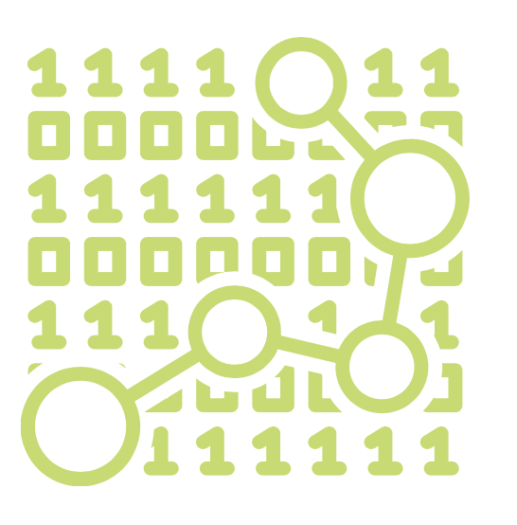
Data
Global gaps in quality data on disability, especially for children. Even bigger gaps at country level.
Useful for informing program design, adaptations mid-cycle, and advocacy
Consider what we collect, how we collect it, and how it’s used
Disaggregation can help us see gaps

Slide 28
Reflection
What kinds of data are we collecting on children with disabilities and their families?
What more should we be collecting? How would we use it to inform program design and adaptations?

Slide 29
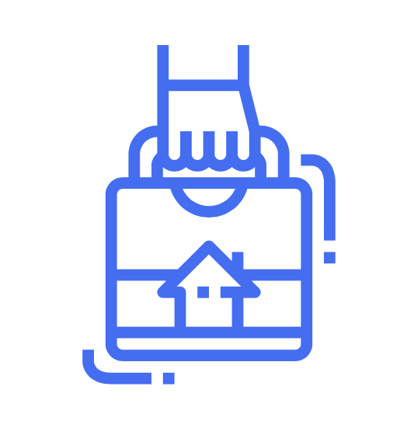
Key Take Away

Slide 30

Closing slide
Changing The Way We Care (CTWWC) is a Global Development Alliance funded by USAID, the MacArthur Foundation, and the GHR Foundation, and implemented by Catholic Relief Services and Maestral International, along with other global, national, and local partners working together to change the way we care for children around the world. Our principal global partners are the Better Care Network, Lumos Foundation, and Faith to Action
Need to know more? Write to info@ctwwc.org or visit changingthewaywecare.org
The photographs in this publication are used for illustrative purposes only; they do not imply any particular health, orphanhood, or residential care status on the part of any person who appears in the photographs.
This product is made possible by the generous support of the American people through the United States Agency for International Development (USAID). The contents are the responsibility of Changing the Way We Care and do not necessarily reflect the views of USAID or the United States Government.
This work is licensed under a Creative Commons Attribution-NonCommercial 4.0 International License.
Notes:
Changing The Way We Care℠ (CTWWC) is a global initiative funded by USAID, the MacArthur Foundation and the GHR Foundation, and implemented by Catholic Relief Services and Maestral International, along with other global, national and local partners working together to change the way we care for children around the world. Our principal global partners are Better Care Network, Lumos Foundation, and Faith to Action. CTWWC’s vision is to be a bold global initiative designed to promote safe, nurturing family care for children, including reforming national systems of care for children, strengthening families, family reunification and preventing child-family separation, which can have harmful, long-term consequences, development of alternative family-based care, and influencing others to build momentum towards a tipping point of change for children.

